Slide 1

Insurance Cost Predictor – rStudio Project
Mohammed Jasim

Slide 2
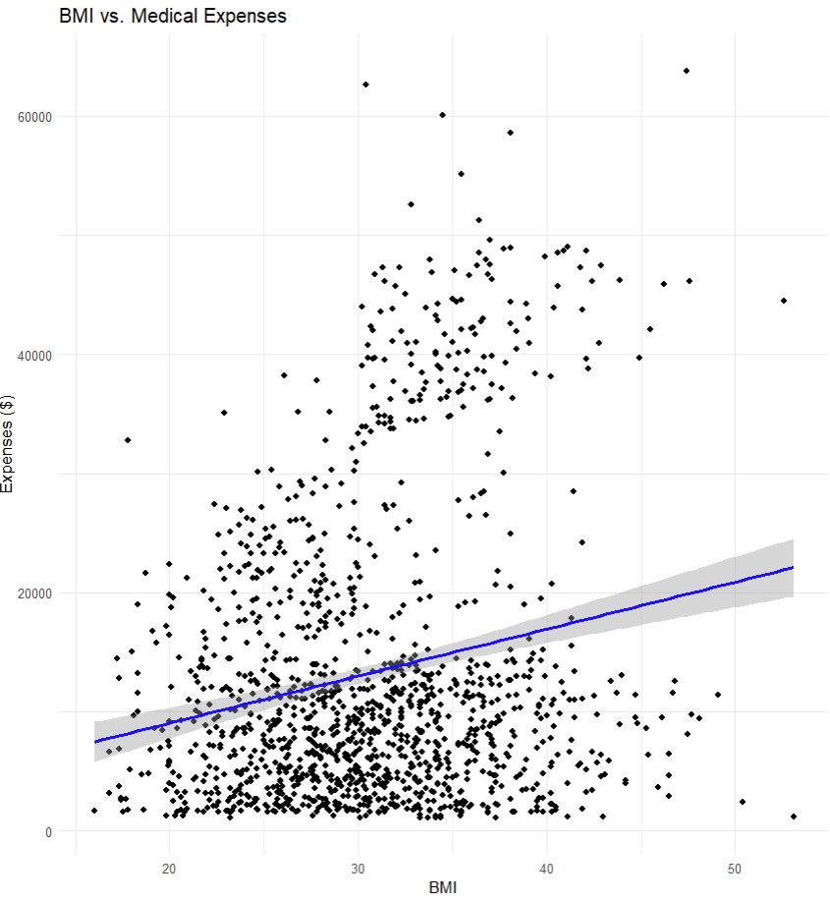
BoxPlot with Insights
Statistically Significant but Limited Relationship: BMI shows a positive correlation with medical expenses ($394.33 per unit increase, p<0.001), but explains only 3.94% of cost variation.
High Data Variability: Expenses vary dramatically at identical BMI values (from $0-$60,000 at BMI 30-35), with visible subgroups suggesting other critical factors at play.
Complex Distribution Patterns: The scatter plot reveals potential non-linear relationships and influential outliers above $50,000, indicating simple linear regression may be insufficient.
Economic Implications: Despite limitations, findings suggest meaningful financial impact—a 5-point BMI difference potentially translates to $2,000 in annual medical costs.
Multivariate Approach Needed: The wide residual range and limited explanatory power strongly indicate that incorporating additional health factors would dramatically improve predictive accuracy.

Slide 3

Description of the analysis
For our simple linear regression analysis, we'll test the following hypotheses:
Null Hypothesis (H₀): There is no linear relationship between BMI and medical expenses (β₁ = 0) Alternative Hypothesis (H₁): There is a linear relationship between BMI and medical expenses (β₁ ≠ 0)
Steps for hypothesis testing:
Set significance level (α = 0.05)
Fit the linear regression model
Examine the t-statistic and p-value for the BMI coefficient
Make a decision: Reject H₀ if p-value < 0.05

Slide 4
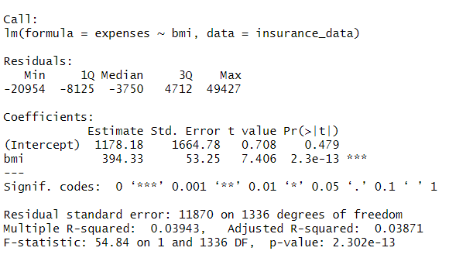
Insights from Simple Linear Regression Analysis: BMI vs. Medical Expenses
Statistically Significant Relationship: The analysis confirms a definitive relationship between BMI and medical expenses (p-value = 2.3e-13, t-value = 7.406), strongly rejecting the null hypothesis at the α = 0.05 significance level. For each unit increase in BMI, medical expenses increase by approximately $394.33.
Limited Explanatory Power: Despite statistical significance, BMI alone explains only 3.94% of the variation in medical expenses (R-squared = 0.0394), indicating that while BMI matters, it's just one of many factors influencing healthcare costs.

Slide 5
Insights Contd.
Clinical and Economic Impact: The findings have tangible financial implications - a 5-point BMI difference could translate to nearly $2,000 in annual medical expense differences, highlighting the potential economic benefit of weight management.
Model Limitations: The wide range of residuals (-20,954 to 49,427) and high residual standard error (11,870) demonstrate that this simple model has significant limitations for accurate individual-level predictions.
Public Health Implications: The results provide quantitative evidence supporting weight management as a potential healthcare cost reduction strategy, though the relatively low R-squared suggests that comprehensive approaches addressing multiple health factors would be more effective than focusing on BMI alone.

Slide 6

Recommendations to Increase Accuracy
Smoker Status: Evidence strongly suggests smoking status would significantly enhance model accuracy. The current model's low R-squared (3.94%) indicates substantial unexplained variance, and smoking is a well-established healthcare cost driver independent of BMI. Including this variable would help isolate BMI's true effect by controlling for this key confounder, likely dramatically improving predictive power.
Age: This fundamental demographic variable directly impacts healthcare costs and utilization patterns. The wide residual range (-20,954 to 49,427) suggests our model misses critical factors like age-related health conditions. Age likely interacts with BMI (creating variable effects across different life stages) and would substantially improve model robustness. The high F-statistic (54.84) but low R-squared confirms our model detects a real but incomplete relationship that age would help clarify.
Including these variables would transform this limited univariate model (explaining only 3.9% of variance) into a more comprehensive multivariate analysis better reflecting the complex determinants of healthcare expenses.

Slide 7
R-Code
# Load library for visualization > library(ggplot2)
> # Read the dataset from Expenses1.csv > insurance_data <- read.csv("C:/Users/moham/Downloads/Expenses1.csv") > > # Check the structure of the data to ensure column nam# Create a scatter plot
> ggplot(insurance_data, aes(x = bmi, y = expenses)) +
+ geom_point() +
+ geom_smooth(method = "lm", color = "blue") +
+ labs(title = "BMI vs. Medical Expenses",
+ x = "BMI", es are correct > str(insurance_data)
# Build simple linear regression model
model <- lm(expenses ~ bmi, data = insurance_data)
# Print detailed summary of the model
cat("\n===== SIMPLE LINEAR REGRESSION MODEL SUMMARY =====\n\n")
summary_output <- summary(model)
print(summary_output)

